Slide 1

Lecture 06: Digital System Design
Dept. of Computer Sc. and Engg.
University of Rajshahi
www.ru.ac.bd
Dr. Mahboob Qaosar

Slide 2
Sequential Circuits
Combinational Logic:
Output depends only on current input
Able to perform useful operations (add/subtract/multiply/…)
Require cascading of many structures
Costly and inflexible

Slide 3
Sequential Circuits (cont.)
Sequential Logic:
Output depends not only on current input but also on past input values
Store information between operations (no need for cascading)
Need some type of memory to remember the past input values

Slide 4
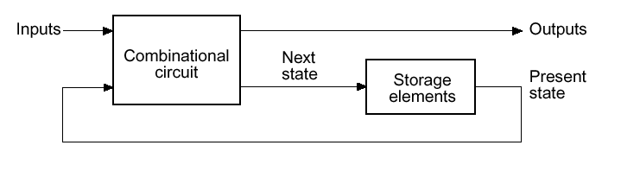
Sequential Circuits (cont.)
Circuits that we
have learned
so far
Information Storing
Circuits
Timed “States”

Slide 5
Sequential Logic: Concept
Sequential Logic circuits remember past inputs and past circuit state.
Outputs from the system are “fed back” as new inputs (usually with delay).
The storage elements are circuits that are capable of storing binary information: memory.

Slide 6
Synchronous vs. Asynchronous machines
There are two types of sequential circuits:
Synchronous (latch mode) sequential circuit: the behavior can be defined from knowledge of its signal at discrete instants of time. This type of circuits achieves synchronization by using a timing signal called the clock.
Asynchronous (fundamental mode) sequential circuit: the behavior is dependent on the order of input signal changes over continuous time, and output can change at any time (clockless).

Slide 7
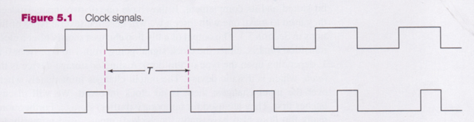
Clock Signal
Clock generator: Periodic train of clock pulses
Different duty cycles

Slide 8
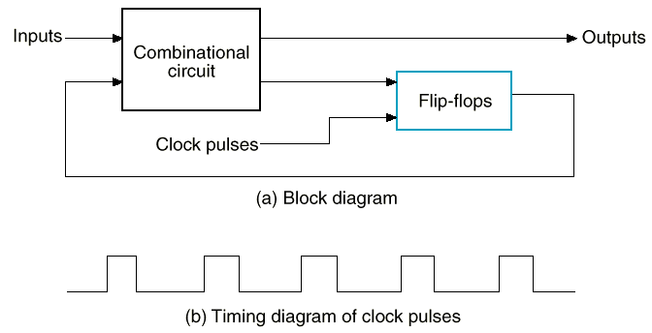
Synchronous Sequential Circuits: Flip flops as state memory
The flip-flops receive their inputs from the combinational circuit and also from a clock signal with pulses at fixed intervals of time, as shown in the timing diagram.

Slide 9
SR Latch (NAND version)
0
S’
S’ R’ Q Q’
Q
1
0 0
0 1
1 0
1 1
1 0 Set
Q’
0
1
R’
X Y NAND
0 0 1
0 1 1
1 0 1
1 1 0

Slide 10
SR Latch (NAND version)
1
S’
S’ R’ Q Q’
Q
1
0 0
0 1
1 0
1 1
1 0 Set
Q’
0
1
R’
1 0 Hold
X Y NAND
0 0 1
0 1 1
1 0 1
1 1 0

Slide 11
SR Latch (NAND version)
1
S’
S’ R’ Q Q’
Q
0
0 0
0 1
1 0
1 1
1 0 Set
0 1 Reset
Q’
1
0
R’
1 0 Hold
X Y NAND
0 0 1
0 1 1
1 0 1
1 1 0

Slide 12
SR Latch (NAND version)
1
S’
S’ R’ Q Q’
Q
0
0 0
0 1
1 0
1 1
1 0 Set
0 1 Reset
Q’
1
1
R’
1 0 Hold
0 1 Hold
X Y NAND
0 0 1
0 1 1
1 0 1
1 1 0

Slide 13
SR Latch (NAND version)
0
S’
S’ R’ Q Q’
Q
1
0 0
0 1
1 0
1 1
1 1 Invalid
1 0 Set
0 1 Reset
Q’
1
0
R’
1 0 Hold
0 1 Hold
X Y NAND
0 0 1
0 1 1
1 0 1
1 1 0

Slide 14
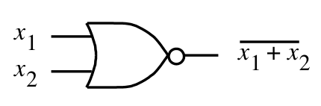
SR Latch (NOR version)
S’
S’
R’
Q
Q’
Q
0
0
0/1 1/0
(no change)
1
0
0
1
0
1
1
0
Q’
1
1
0
0
(invalid)
R’
(a) Circuit
(b) Truth table
NOR Gate Truth table
x₁ | x₂ | f
0 | 0 | 1
0 | 1 | 0
1 | 0 | 0
1 | 1 | 0

Slide 15
SR Latch with Enable signal (Gated SR Latch)
S
S’
Q
EN
Q’
R
R’
S R EN S’ R’ Q Q’
0 0 1 1 1 Q₀ Q₀’ Store
0 1 1 1 0 0 1 Reset
1 0 1 0 1 1 0 Set
1 1 1 0 0 1 1 Disallowed
X X 0 1 1 Q₀ Q₀’ Store
Latch is sensitive to input changes ONLY when EN=1

Slide 16
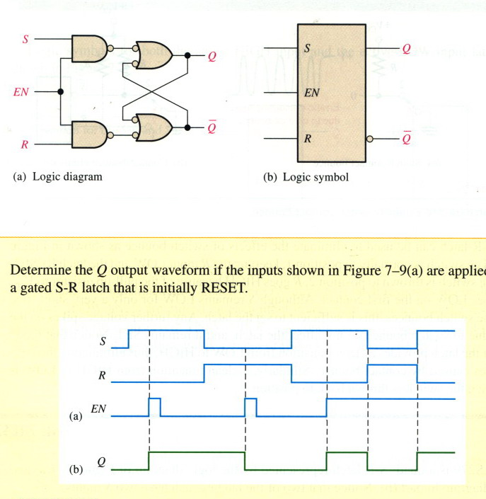
SR Latch with Enable signal (cont.)

Slide 17
Flip-Flops
Latches are “transparent” (= any change on the inputs is seen at the outputs immediately).
This causes synchronization problems!
Solution: use latches to create flip-flops that can respond (update) ONLY on SPECIFIC times (instead of ANY time).

Slide 18
Alternatives in FF choice
Type of FF
SR
D
JK
Type of triggering
Untriggered (asynchronous)
Level-triggered (EN = 1)
Edge-triggered (rising or falling edge of CLK)

Slide 19
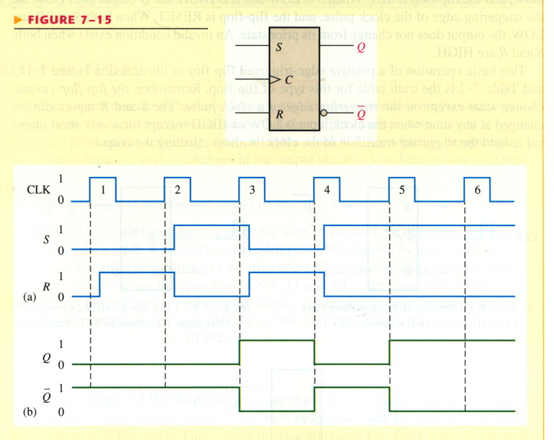
Edged-Triggered SR FF

Slide 20
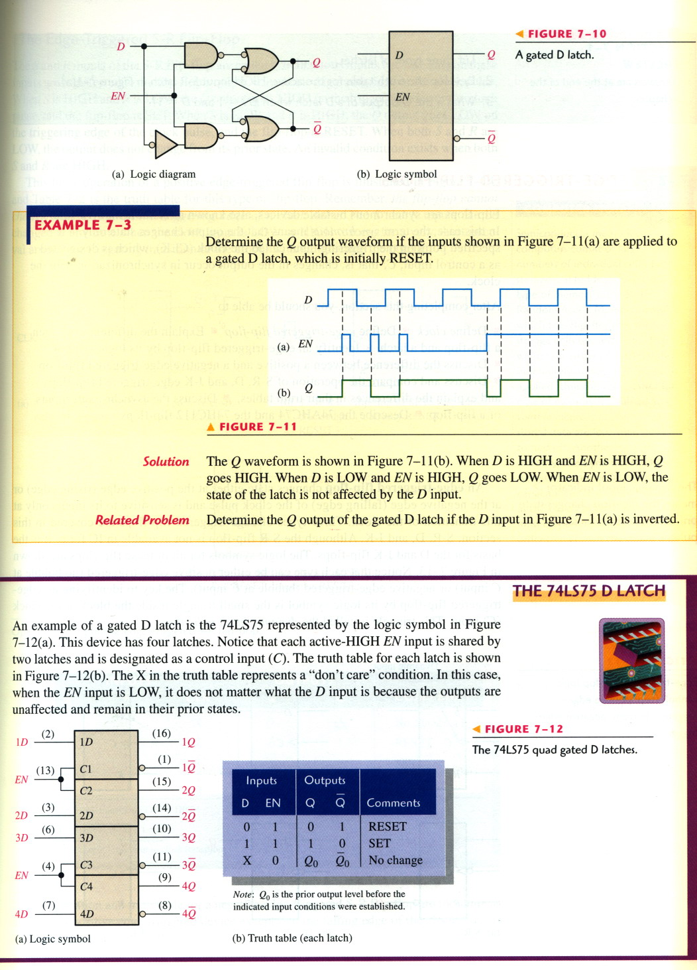
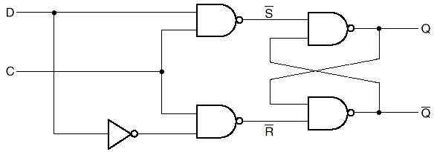
D Latch
Ensures S and R inputs never equal to 1 at the same time
Useful in control application where setting or resetting a flag to some condition is needed
Stores bits of information
Constructed from a gated SR latch and a Data latch This is done in the D latch:
EN

Slide 21
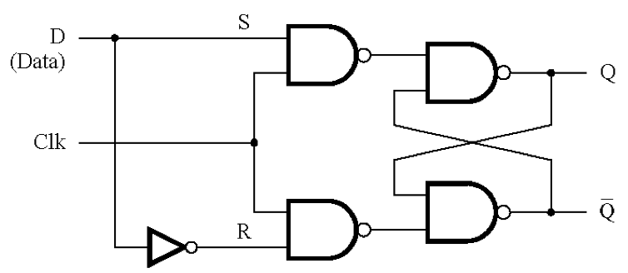
D Latch (cont.)
S R CLK Q Q’
D CLK Q Q’
0 0 1 Q₀ Q₀’ Store
0 1 1 0 1 Reset
1 0 1 1 0 Set
1 1 1 1 1 Disallowed
X X 0 Q₀ Q₀’ Store
0 1 0 1
1 1 1 0
X 0 Q₀ Q₀’

Slide 22
D latch: store it and look it up
Output depends on clock
Clock high: Input passes to output
Clock low: Latch holds its output
Latches are level sensitive and “transparent”
Input
D
Q
Output
Q
Output
CLK
CLK
D
Q_{latch}

Slide 23
D flip-flop
Input sampled at clock edge
Rising edge: Input passes to output
Otherwise: Flip-flop holds its output
Flip-flops can be rising-edge triggered or falling-edge triggered
Input
D
Q
Output
Q
Output
CLK
CLK
D
Q_{ff}

Slide 24
Flip-Flop Vs. Latch
The primary difference between a D flip-flop and D latch is the EN/CLOCK input.
The flip-flop’s CLOCK input is edge sensitive, meaning the flip-flop’s output changes on the edge (rising or falling) of the CLOCK input.
The latch’s EN input is level sensitive, meaning the latch’s output changes on the level (high or low) of the EN input.
Notes:
This slide details the primary difference between the often confused D flip-flop and D latch.

Slide 25
Flip-Flop Vs. Latch (cont.)
D
Q
CLK
D
Q_{ff}
Q_{latch}
Q
CLK
D
Q
Q
CLK
behavior is the same unless input
changes while the clock is high

Slide 26
Clock Edges
Positive Edge Transition
1 0
1 0
Negative Edge Transition

Slide 27
PGT & NGT
Positive-Going Transition (PGT) Trigger
D | CLK
0 | ↑ | 0 | 1
1 | ↑ | 1 | 0
↑ : Rising Edge of Clock
D
Q
CLK
Negative-Going Transition (PGT) Trigger
D | CLK
0 | ↓ | 0 | 1
1 | ↓ | 1 | 0
↓ : Falling Edge of Clock
D
Q
CLK
Notes:
Schematic symbol and excitation table for the positive edge triggered and negative edge triggered D flip-flops

Slide 28
Flip-Flop Timing
Synchronous control input | 1 0
 |  |  | t_{S} Setup Time |  |  |  |  |  |  |  |  | t_{H} Hold Time
Positive Edge Clock | 1 0
Setup Time (t_{S}): The time interval before the active transition of the clock signal during which the synchronous input must be maintained.
Hold Time (t_{H}): The time interval after the active transition of the clock signal during which the synchronous input must be maintained.
Notes:
Definition of the Setup & Hold Time timing parameters for a flip-flop.

Slide 29
Asynchronous Inputs
Asynchronous inputs (Preset & Clear) are used to override the clock/data inputs and force the outputs to a predefined state.
The Preset (PR) input forces the output to:
The Clear (CLR) input forces the output to:
PR
D
Q
CLK
CLR
PR PRESET | CLR CLEAR | CLK CLOCK | D DATA
1 | 1 | ↑ | 0 | 0 | 1
1 | 1 | ↑ | 1 | 1 | 0
0 | 1 | X | X | 1 | 0 | Asynchronous Preset
1 | 0 | X | X | 0 | 1 | Asynchronous Clear
0 | 0 | X | X | 1 | 1 | ILLEGAL CONDITION
Notes:
Definition for the PR (preset) and CLR (clear) Asynchronous input for a D flip-flop.

Slide 30
D Flip-Flop: PR & CLR Timing
Q=D=1
Clocked
Q=D=0
Clocked
Q=D=0
Clocked
Q=D=1
Clocked
Q=D=1
Clocked
Q=D=0
Clocked
Q
PR
CLR
D
CLK
Q=1
Preset
Q=1
Preset
Q=0
Clear
Notes:
Time diagram showing the effects of the synchronous inputs (D & CLK) and asynchronous inputs (PR & CLR).

Slide 31
JK-FF
Widely used type of flip-flop.
The functioning is identical to that of the SR-FF in the SET, RESET, and NO CHANGE.
The difference is that the JK-FF has NO invalid state as does the SR-FF.
J | K | CLK | Q
0 | 0 | ↑ |  | No Change
0 | 1 | ↑ | 0 | Clear
1 | 0 | ↑ | 1 | Set
1 | 1 | ↑ |  | Toggle
↑ : Rising Edge of Clock
J
Q
CLK
K

Slide 32
JK Flip-Flop: Timing Diagram
NO
CHANGE
NO
CHANGE
SET
TOGGLE
TOGGLE
CLEAR
SET
Q
J
K
CLK
Notes:
Timing diagram example for a J/K flip-flop.

Slide 33
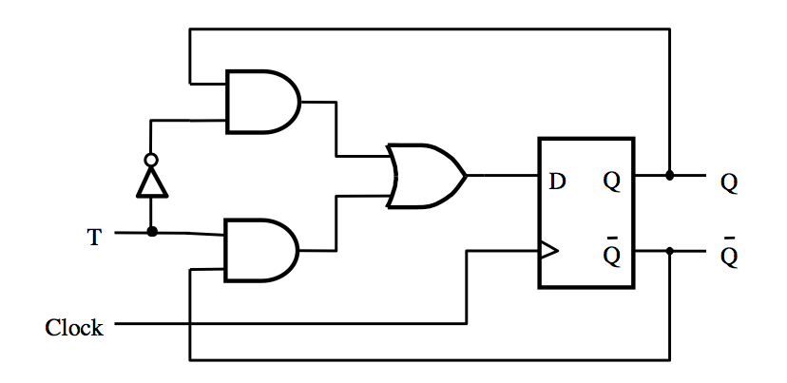
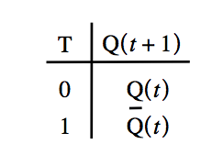
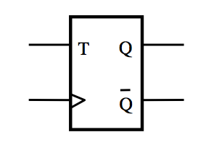
T Flip-Flop
If T=0 then it stays in its current state
If T=1 then it reverses its current state

Slide 34
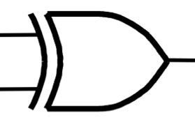
T-FF using D-FF & JK-FF
T
J
Q
Clock
T
D
Q
Q
K
Q
Clock

Slide 35
End

